Slide 1
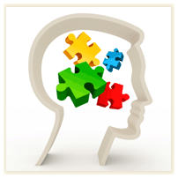
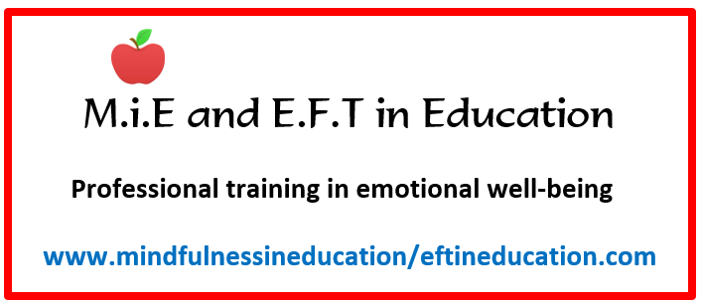
WELCOME TO MINDFULNESS
IN EDUCATION TRAINING FOR YOUNG ADULTS
LESSON ONE
THE BRAIN ON AUTOPILOT

Slide 2
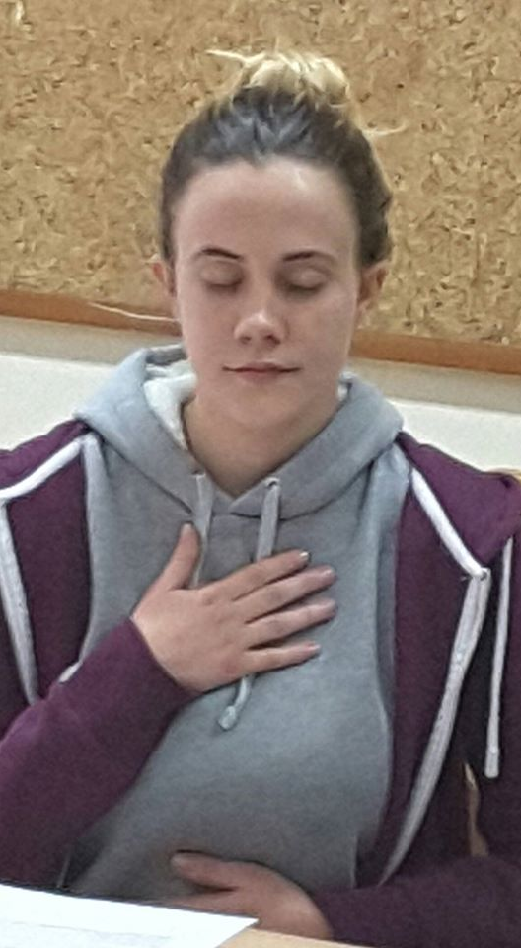
WHAT IS MINDFULNESS?
Notes:
Let’s start off by finding out what mindfulness is. Above is Teacher from Malta. PRACTICE OF MF ITSELF IS NOT RELIGIOUS…ACADEMIC….RELAXATION (THOUGH YOU WILL FEEL RELAXED) MF IS MORE ABOUT BEING AWAKE, BEING AWARE, NOTICING WHAT YOU FEEL, HOW YOU REACT, BEHAVE AND MORE…Explain how when we think of negative things from the past it can make us feel sad or depressed and when we worry about the future we might feel anxious. If we practice more of being in the present, we can avoid these negative feelings.
How to belly breathe https://www.youtube.com/watch?v=-HDyXTsSjto
MF FORM OF MEDITATION PRACTICED FOR 1,000’s YEARS. USED IN HOSPITALS ETC TO TREAT DEPRESSION, ANXIETY AND PAIN. We don’t learn ABOUT mindfulness…more we BECOME Mindful. Can only be achieved through practice.

Slide 3
WHAT YOU WILL LEARN OVER THE NEXT 6 WEEKS:
To experience greater well-being (e.g. feel happier, calmer, more fulfilled)
To fulfil potential and pursue own goals e.g. be more creative, more relaxed, academically, personally
To improve concentration and focus, in classes/exams and tests/on the sports field, when listening to others and more
To work with difficult mental states such as depressive, ruminative and anxious thoughts and low moods
To cope with the everyday stresses and strains of adolescent life such as exams, relationships, sleep problems, family issues

Slide 4
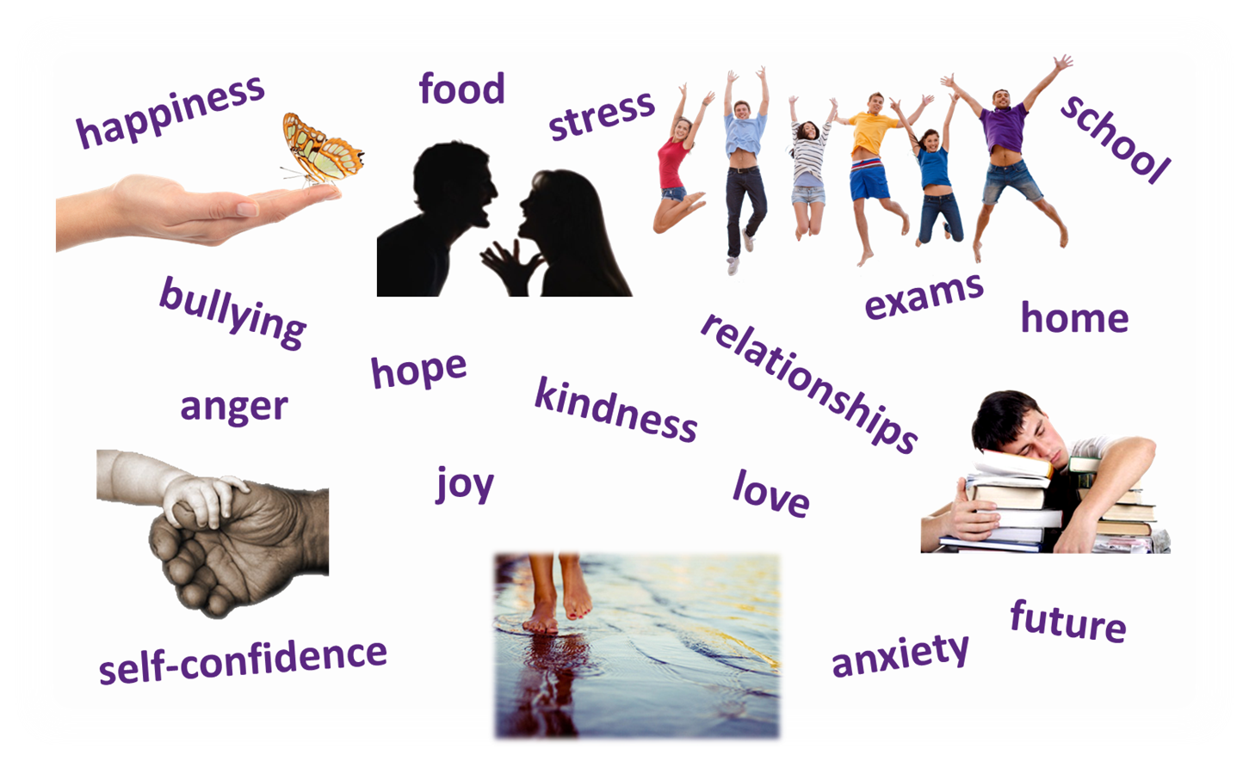
WHAT MINDFULNESS MIGHT HELP WITH
Notes:
Why has MF might also help with the above. Why it being introduced into school? Well 1000’s of schools around the world have introduced MF into the classroom and also teachers learn it (they have in Malta). In the UK the Govt are committed to spending £millions on MF in education because it has been scientifically proven to work. It is also used in the Military, Hospitals, Prisons, Houses of Parliament, Teachers, Workplace etc…. Let’s see what these teenagers think about MF….

Slide 5
WHAT YOUTHS THINK OF MINDFULNESS
Notes:
Weblink: https://www.youtube.com/watch?v=kk7IBwuhXWM

Slide 6
Notes:
So let’s begin These days our mind is flooded with too much information and things to remember. We’re NOT being mindful most of the time except when we daydream perhaps! We have places to go, things to do ……internet, TV, Facebook, What’s App, school lessons, homework, hobbies, friends, family…… Always something to do or something to remember. We have more information at our fingertips but we are not more intelligent than we were before all this information was available to us. When the mind gets flooded with information it creates ‘shortcuts’ (learn later) or puts you on autopilot. Q: Can you think of things you do on autopilot? (Use mobile, brush teeth, ride bike, play instrument, eat…..) Once your brain recognises you do this all the time it creates a pathway. We call this ‘Neuroplasticity’Can you think of times when trying to do too much can be dangerous?
The mind needs S P A C E so it can work more effectively at remembering things and Mindfulness breathing practices can help with that by training the brain to become still and quiet to calm down some of the activity.

Slide 7
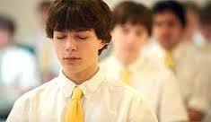
PRACTICE
Notes:
Let’s see if we can begin to train your brain! Mindfulness practice (min 5mins).

Slide 8
NEUROPLASTICITY IN ACTION
Notes:
Weblink: https://www.youtube.com/watch?v=ELpfYCZa87g
It’s important that students understand that by practicing something new, the brain will build a new pathway to make it easier for us. That’s good news if it’s something helpful like learning how to use a new mobile phone or remember tel number of girlfriend but what if it was a bad habit like smoking or feeling anxious? Now we know that the brain can build new pathways….we just have to keep practicing. Please ensure they understand this. Now let’s find out a bit more about the brain….

Slide 9
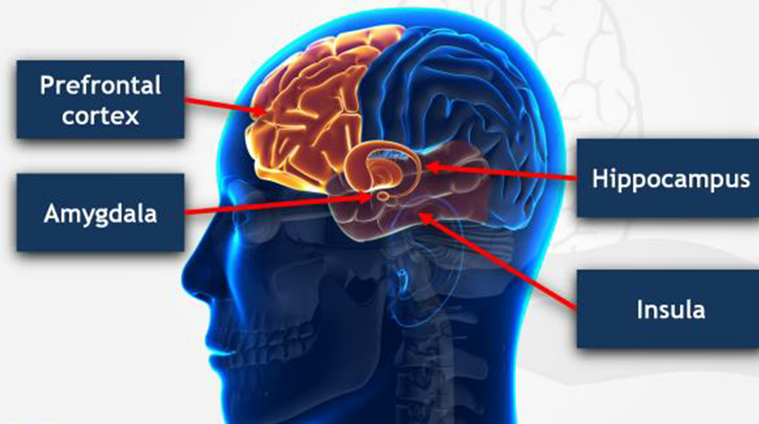
Notes:
You may hear mind and brain used. They are different. Best way is to say the Brain is the organ (can touch and feel it). We can’t see or feel the mind but it’s what makes us act on the brain. Thoughts, beliefs, imagination etc. Every brain is similar but every mind is different as it depends on experiences in life. A Teenage brain is different. Between 15-17yrs Bec. Brain not fully developed more risks taken, impatient and impulsivity greater.
Amygdala (Fear) This organ in the brain acts like a guard dog, always looking after our safety. Looks out for threat or worry. Sometimes does too good a job! If we get stressed, it can make us feel anxious, nervous and angry. The hippocampus may decide to keep memories in the amygdala so we can remember when to feel scared or not. This is not always helpful when you no longer need to be scared of something!
Hippocampus (Memory) Where we keep our memories such as a birthday or what you learned in class. The hippocampus also decides which memories to keep and which to store away. It usually keeps memories that have an emotion attached to them. Remember: If amygdala is too active, the hippocampus can’t do its job in remembering. You may know this when put under pressure to remember something!
Pre frontal cortex (learning) Is good at learning and deciding if doing something is good or bad. Helps us to wait and be patient. When we breathe, we can help the pre frontal cortex and the hippocampus to calm down the amygdala.
The Insula helps us to regulate our moods to keep us healthy and well and enables us to show compassion. Question? How many brains do you have? Let’s see. [click]

Slide 10
Notes:
We actually have 3 brains – congratulations if you got that one right. The best way to explain these 3 brains is to show you my arm. 1) Reptilian or Lizard Brain: From your elbow up to the palm of your hand. This represents the oldest brain that we call the reptilian brain. All creatures have this. Survival brain. This is where organ the amygdala can be found. Responsible for Fight, Flight, Freeze response.
2) Limbic Brain or Mammalian Brain: Like the thumb over the palm of your hand (actually you have two limbic systems). We make decisions, based on memories. This is where we store our emotions and where we can find the hippocampus (we actually have two called hippocampi) that keeps short term memories before moving them to other parts of our brain. The insula is also here and reacts to our moods. A dog would have a mammalian brain but needs the human brain to do things we humans can only do….write…..talk……drive a car (well maybe!)
3) Cortex: The front part of this ‘new’ brain (the fingers that fold over the thumb) is called the pre frontal cortex. This is what makes humans different to animals. This is where we make decisions, learn and plan. When we practice mindfulness, we can help the pre frontal cortex calm down the amygdala and the hippocampi so we can learn and remember the important things. You will be learning more about the brain throughout the course and get to know it better. Now let’s see this short film clip (1.5mins) They all have to work together so if one shuts down, the others are affect. Much like a computer network. In fact signals are sent via pathways in the body that are much like electrical wires.

Slide 11
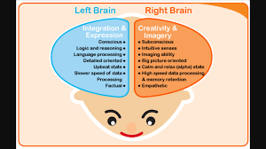
Notes:
Explain the difference between the right and the left brain and how mindfulness can help engage both. Why it’s not good to be too much in the left brain or right brain.

Slide 12
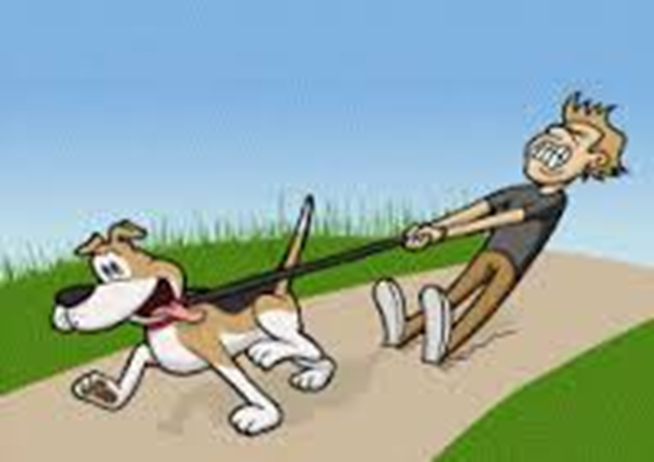
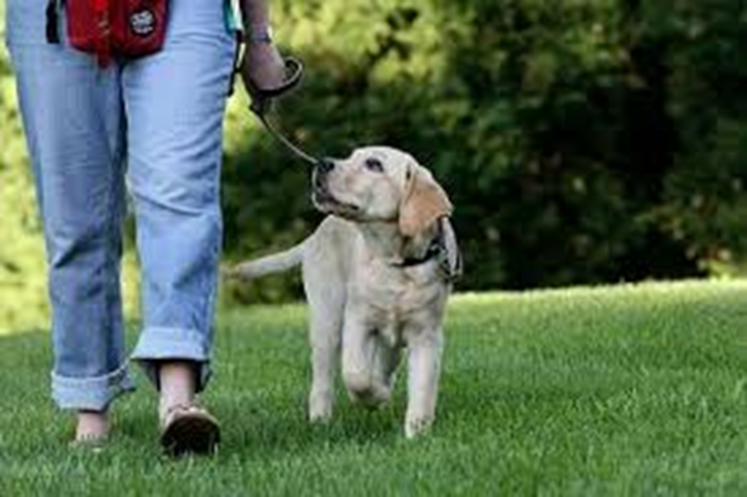
MIND IS LIKE A PUPPY DOG
Notes:
Explain how the mind wants our attention all the time – especially when it expects you to be busy but we can train it and tame it….… Practice focusing your attention to your feet right now. Do you ever notice the shoes on your feet or how they feel? Probably not because they are just here. When did you last notice your breathing? How can you actually train your mind? First, lets see if you can hold your attention on one thing for 90 seconds. It can be the breathe, nose, arm, knee, toe…. [click]

Slide 13
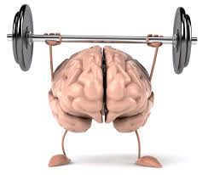
YOU CAN TRAIN YOUR BRAIN!
Notes:
Remember in the earlier clip we talked about Neuroplasticity? The brain has the ability to grow and develop if we instruct it long enough. Mindfulness can help the mind calm down and in the process help us retain information and help us learn. To do this we have to practice the exercises every day to see results just like going to the gym. Paying attention to everything that is going on around you like you are an alien and seeing or hearing things or the first time helps your brain to become more aware and focus. You need to focus to learn and retain information for exams. Let’s try the Raisin Exercise to help us focus and enjoy the moment. Mindfulness is being in the present.

Slide 14
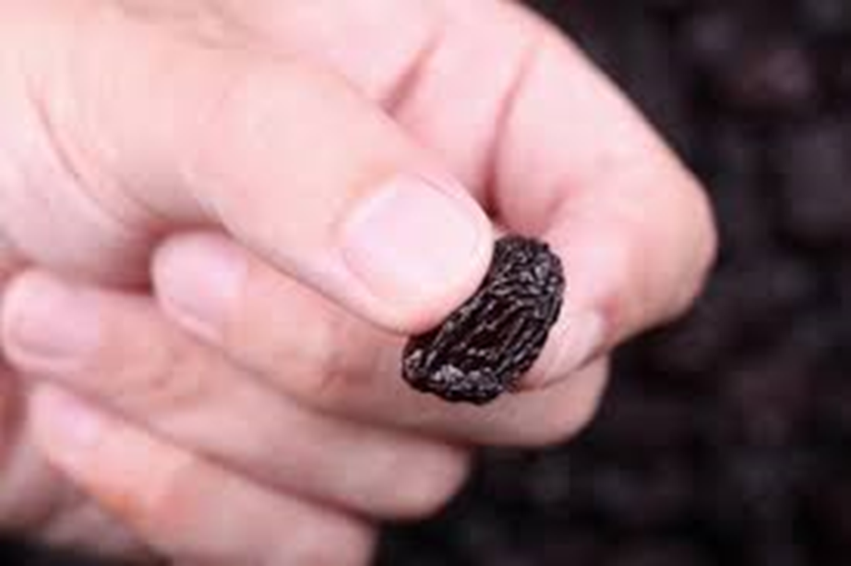
RAISIN EXERCISE
Notes:
Use exercise

Slide 15
PRACTICE
Notes:
Mindfulness practice (min 5mins). Don’t forget Home Practice.

Slide 16
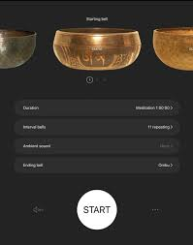
FREE APP FOR YOUR PHONE
www.insighttimer.com
Notes:
Encourage them to use this. Can set time, sound of bell etc. Can also access guided meditations. There are other apps but this one is free. Share any others you think may be useful but make sure they are professional meditations.

